Slide 1
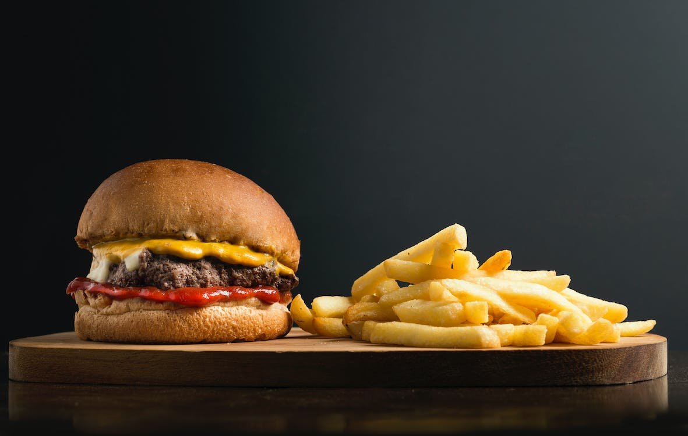

TASTE TREASURE
Food Restaurant
Presented by: Czarina Khyle Lopez

Slide 2

TOPIC
INTRODUCTION
a food restaurant where they can buy what they want to eat
a food restaurant where they can buy what they want to eat
the users can see that the foods I sell are worth it and fit in your budget, not only cheap but also clean and well cooked.

Slide 3

Why I Choose this Topic
The objectives of the creation of the taste treasure website
is to guarantee client happiness, loyalty, and profitability.
I want to be able to open my own restaurant in the future.
I also love cooking and all the things I sell are one of my favorite foods.
i want to sell foods that are delicious but can be afforded by anyone, especially to other students and working people who save their food.

Slide 4

TECHNOLOGIES EQUIPMENT
HTML
CSS
BOOTSRAP
GIT HUB

Slide 5

THANK YOU!

